Slide 1
XFINITY Home Security (XHS) Comcast Home Automation
Tuesday, October 25, 2011

Slide 2
Home Security/Automation
Broadband Home Security Market is an Attractive New Line of Business for Comcast
Large, fragmented market with over 20 million homes in US, mostly served by small regional players
Ties to existing businesses (product convergence) and in leveraging the network
Comcast is Positioned to Enter Home Security/Automation Market
Leveraging existing marketing engine, particularly the millions of moves Comcast handles annually
New technology can leverage Internet, voice and video for additional value add
Comcast Product Strategy Based on Differentiated Features and Packaging
Touch screen provides widgets such as live video, lighting, thermostat, weather, news, calendar, word of the day, Sudoku
Monitor home activity remotely and get alerts (“find out when Johnny gets home from school each day”)
Eight Comcast Markets Launched
Houston, Portland, Chattanooga, Naples/Sarasota, Nashville, Freedom, Jacksonville and Knoxville
Notes:
2

Slide 3
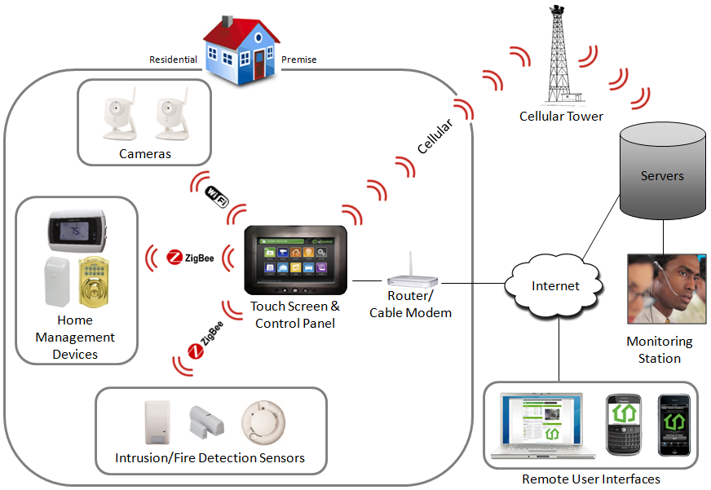
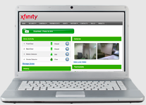
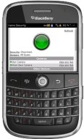
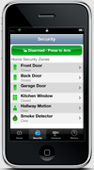
XFINITY Home Security
3

Slide 4
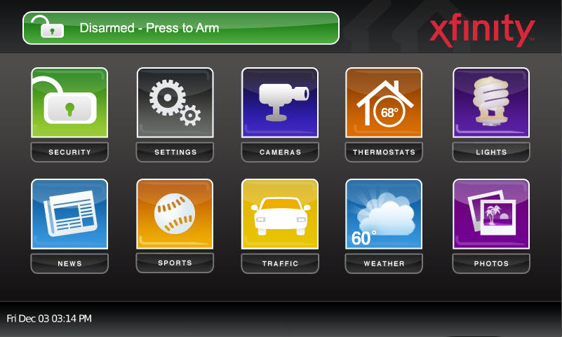
iControl SMA Touchscreen
Core Home Security - redundant connection over Broadband and Cellular
Battery backup for power outages
Full screen live video view from in-home cameras
Smash and Grab Protection
Connected to a 24/7 central monitoring station - email and SMS notifications on alarms
Email and SMS notifications for zone or non-alarm monitoring
Apps Platform (e.g., live video, lighting, thermostat, weather, news, calendar, word of the day, Sudoku)

Slide 5
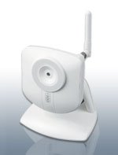
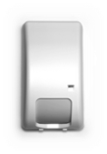
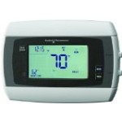
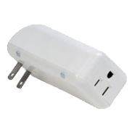
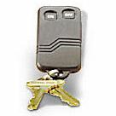
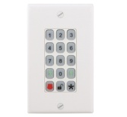
Available Sensors and Peripherals
Door/Window
Contacts
Indoor Video
Camera
Motion
Detectors
Indoor/Outdoor
Camera
Glass Break
Detectors
Thermostat
Smoke
Detectors
Lighting /
Appliance Module
Key Fobs
Wireless Keypad
Note: Pictures not to scale

Slide 6
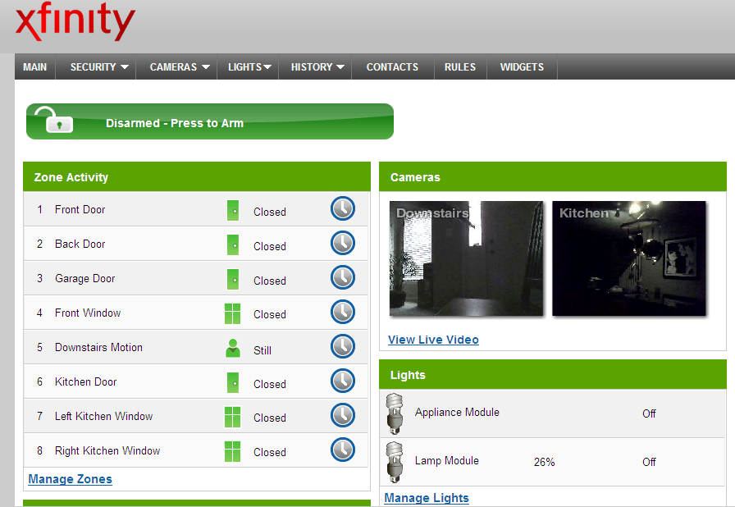
iControl Subscriber Portal

